Slide 1

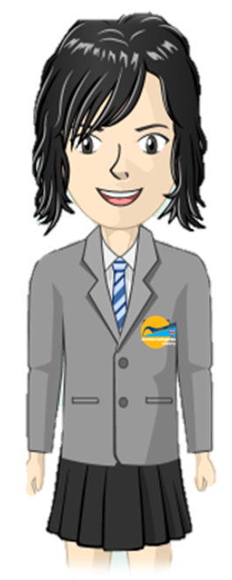
Where are areas of surplus and deficit located globally?
Elements Primary
Science
Learning Journey
The Bigger Picture
Chemistry
•Compare how things move on different surfaces
Identify and compare uses of different materials
Simple food chains & habitats
Growing plants (water, light, warmth)
Biology
Classify materials according to a variety of properties
Basic needs of animals & offspring
Differentiate living, dead and non-living
Compare & classify materials
Observe weather associated with changes of season
Physics
Fountains-Year 2
Chemistry
Describe simple properties of some materials
Distinguish between objects & materials
Identify & compare common animals
Identify basic plants
Biology
Identify & name common materials
Identify & name basic body parts
Identify basic plant parts (roots, leaves, flowers, etc.)
Fountains-Year 1

