Slide 1

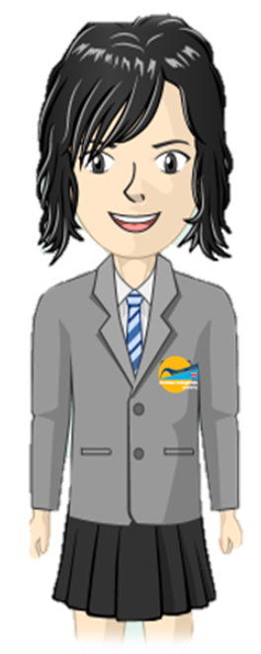
Where are areas of surplus and deficit located globally?
Elements Primary
Science
Learning Journey
Physics
The Bigger Picture
Electricity: investigating circuits
Light & Shadows; the eye
Health & Lifestyles, incl. circulatory system
Biology
Forces, including gravity
Evolution & Adaptation
Classification, including micro-organisms
Understand location and interaction of Sun, Earth & Moon
BB2-Year 6
Physics
5
Chemistry
Know about reversible changes; identify irreversible
Introduce gravity, resistance & mechanical forces
Understand mixtures & solutions
Describe changes as humans develop & mature
Biology
Classify materials according to a variety of properties
Life cycles of plants & animals (inc. mammal, insect, bird, amphibian)
Water cycle
Electricity: simple circuits & conductors
Physics
BB2-Year 5
Chemistry
Sound as vibrations
Changes of state
Food chains
Classify living things
Biology
Digestive system & teeth
Sources of light; shadows & reflections
Simple forces, including magnetism
Physics
BB1-Year 4
Chemistry
Simple understanding of fossilization
Classification of rock types
Plants including lifecycle and requirements for life
Biology
BB1-Year 3
Animals: skeletons & nutrition

