Slide 1

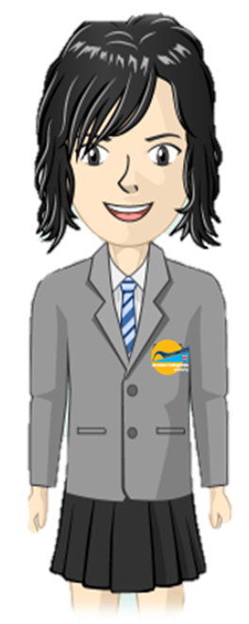
Where are areas of surplus and deficit located globally?
Elements Primary
Numeracy
Learning Journey
The Bigger Picture
Interpret simple tables & pictograms
Ask & answer questions about totalling
Data
5
Understand equivalence of e.g. 2/4 = 1/2
Ask & answer comparison questions
Fractions
Use terminology of position & movement’
Order and arrange mathematical objects
Read scales to nearest whole unit
Know and use standard measures
Recognise commutative property of multiplication
Know number facts to 20 (+ related to 100)
Use x and ÷ symbols
Write numbers to 100
Find and write simple fractions
Identify, represent & estimate numbers
Geometry & Measures
Number & Calculation
Identify 2-d shapes on 3-d surfaces
Tell time to the nearest 5 minutes
Use symbols for £ and p and add/subtract simple sums of less than £1 or in pounds
Begin to use place value (T/O)
Identify & sort 2-d & 3-d shapes
Compare / order numbers, inc. < > =
Count in 2s, 3s, 5s & 10s
Know 2, 5, 10x tables
Describe position & movement, including half and quarter turns
Foundations-Year 2
Order & arrange objects
Fractions
Use language of days, weeks, months & years
Recognise & use ½ & ¼
Geometry &
Measures
Recognise & name common 2-d and 3-d shapes
Use language, e.g. ‘more than’, ‘most’
Identify ‘one more’ and ‘one less’
Count in 1s, 2s, 5s and 10s
Begin to measure length, capacity, weight
Use time & ordering vocabulary
Solve one-step problems, including simple arrays
Know number bonds to 20
Number & Calculation
Tell the time to hour/half-hour
Use common vocabulary for comparison, e.g. heavier, taller, full, longest, quickest
Recognise coins & notes
Add and subtract one-digit and two-digit numbers to 20, including zero
Use +, - and = symbols
Read & write numbers to 20
Count to / across 100
Foundations-Year 1

