Slide 1

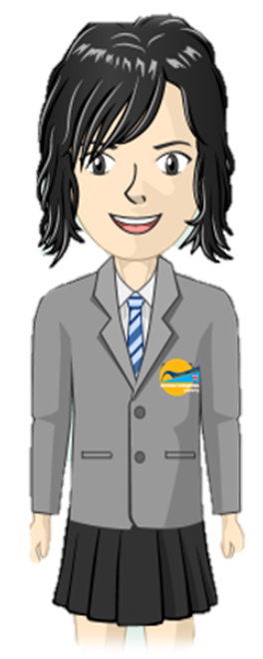
Where are areas of surplus and deficit located globally?
Introduce simple use of unknowns
Elements Primary
Numeracy
Learning Journey
Calculate mean averages
Algebra
The Bigger Picture
Use pie charts
Data
Introduce ratio & proportion
Use written division up to 2dp
Know and use angle rules
Solve problems using decimals & percentages
Multiply simple fractions
Compare & simplify fractions
Use area & volume formulas
Confidently use a range of measures & conversions
Identify factors, multiples & primes
Fractions, Decimals & Percentages
Geometry & Measures
All written methods, including long division
Divide fractions by whole numbers
Calculate area of triangles / parallelograms
Solve multi-step number problems
Use order of operations (not indices)
Use equivalents to add fractions
Translate & reflect shapes, using all four quadrants
Classify shapes by properties
Secure place value & rounding to 10,000,000, including negatives
Multiply fractions by units
Order & round decimal numbers
Number & Calculation
Fractions, Decimals & Percentages
BB2-Year 6
Data
Compare & order fractions
5
Add & subtract fractions with common denominators, with mixed numbers
Write decimals as fractions
Link percentages to fractions & decimals
Interpret tables & line graphs
Solve questions about line graphs
Understand regular polygons
Reflect & translate shapes
Calculate perimeter of composite shapes & area of rectangles
Use vocabulary of prime, factor & multiple
Use standard written methods for all four operations
Use square and cube numbers
Measure & identify angles
Geometry & Measures
Number & Calculation
Identify 3-d shapes
Confidently add & subtract mentally
Use negative whole numbers in context
Estimate volume & capacity
Convert between different units
Multiply & divide by powers of ten
Use Roman numerals to 1000 (M)
Recognise common equivalents
Secure place value to 1,000,000
Introduce simple translations
Identify equivalent fractions
Solve money problems
Fractions & Decimals
BB2-Year 5
Data
Use first quadrant coordinates
Recognise tenths & hundredths
Add & subtract fractions with common denominators
Round decimals to whole numbers
Use bar charts, pictograms & line graphs
Identify symmetry
Estimate & calculate measures
Find area by counting squares
Use standard short multiplication
Column addition & subtraction up to 4 digits
Round numbers to nearest 10, 100 or 1000
Secure place value to 10000
Geometry & Measures
Number & Calculation
Know all tables to 12 x 12
Identify acute, obtuse & right angles
Calculate rectangle perimeters
Compare 2-d shapes, including quadrilaterals & triangles
Multiply & divide mentally
Use Roman numerals to 100 (C)
Use negative whole numbers
Order fractions with common denominator
Use & count in tenths
Recognise some equivalent fractions
Fractions & Decimals
BB1-Year 4
Identify horizontal, vertical, perpendicular and parallel lines
Data
Recognise, find & write fractions
Add/subtract fractions up to 1
Interpret bar charts & pictograms
Identify and use right angles
Draw 2-d / Make 3-d shapes
Solve number problems, including multiplication & simple division and missing number problems
Mentally add & subtract units, tens or hundreds to numbers of up to 3 digits
Add/subtract using money in context
Measure & calculate with metric measures
Learn 3, 4 & 8x tables
Geometry & Measures
Number & Calculation
BB1-Year 3
Calculate using simple time problems
Use Roman numerals up to XII; tell time
Measure simple perimeter
Use commutativity to help calculations
Written column addition & subtraction
Secure place value to 1000

