Slide 1

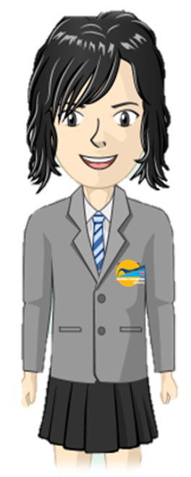
Where are areas of surplus and deficit located globally?
Elements Primary
Literacy
Learning Journey
The Bigger Picture
Use simple conjunctions
Begin to expand noun phrases
Use some features of standard English
Initiate & respond to comments
Use . ! ? , and ’
Grammar
S & L
5
Record ideas sentence-by-sentence
Make simple additions & changes after proof-reading
Articulate & Justify answers
Use spoken language to develop understanding
Begin to plan ideas for writing
Spell using common suffixes, etc
Learn to spell common ‘exception’ words
Begin to make inferences
Become familiar with & retell stories
Read common ‘exception’ words
Read common suffixes
Develop positive attitude & stamina for writing
Writing
Reading
Use appropriate size letters & spaces
Spell by segmenting into phonemes
Ask & answer questions; make predictions
Discuss & express views about fiction, non-fiction & poetry
Read & re-read phonic-appropriate books
Develop phonics until decoding secure
Form lower case letters correctly
Begin to use basic punctuation: . ? !
Use common plural & verb suffixes
Ask relevant questions
Grammar
Foundation
Year 2
Read own writing to peers or teachers
S & L
Leave spaces between words
Use capital letters for proper nouns.
Listen & respond appropriately.
Maintain attention & participate.
Compose sentences orally before writing
Make simple predictions
Read phonics books aloud
Read words with very common suffixes
Read accurately by blending sounds
Form capital letters & digits
Use very common prefixes & suffixes
Spell very common ‘exception’ words
Join in with predictable phrases
Writing
Reading
Form lower case letters correctly
Name letters of the alphabet
Discuss significance of title & events
Link reading to own experiences
Read contractions & understand purpose
Match graphemes for all phonemes
Name letters of the alphabet
Foundations
Year 1

