Slide 1
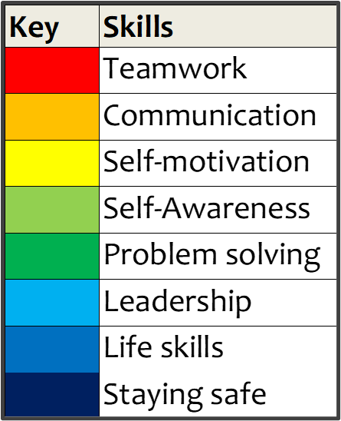
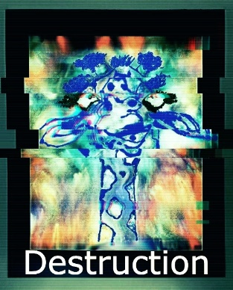
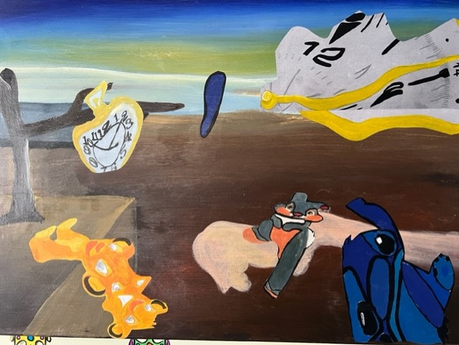
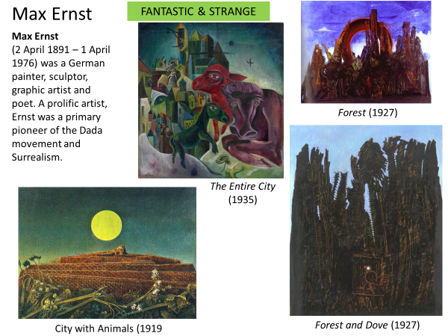
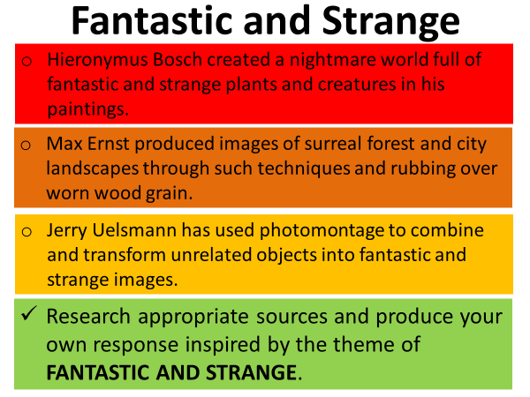
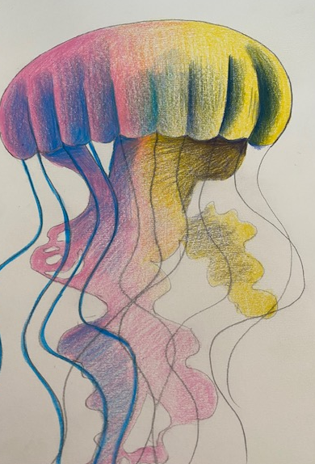
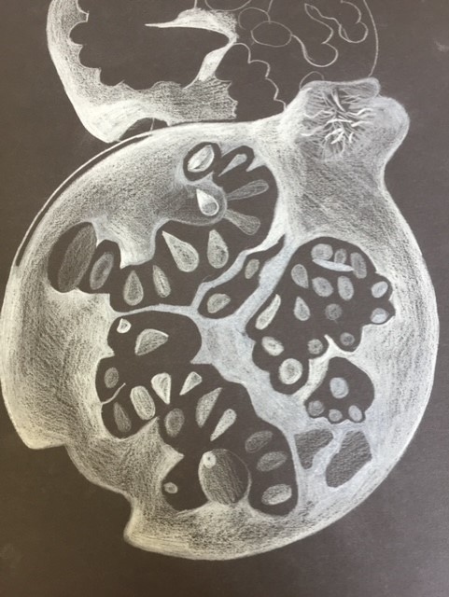
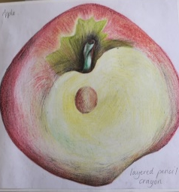
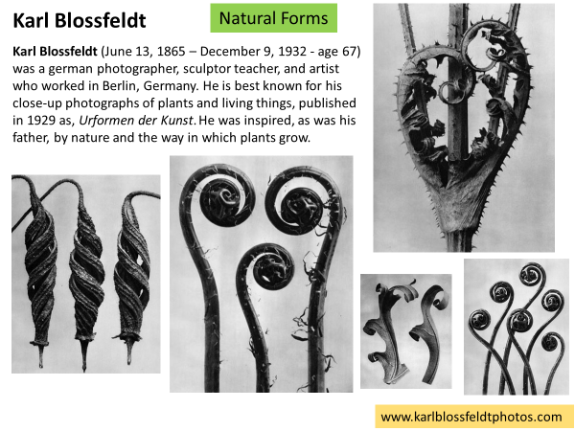
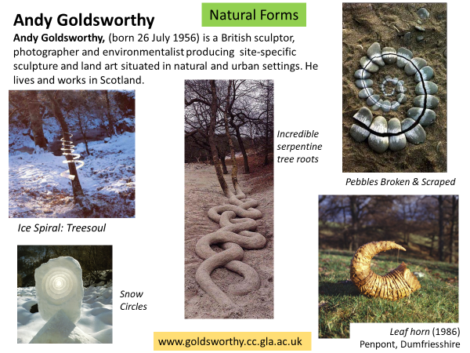
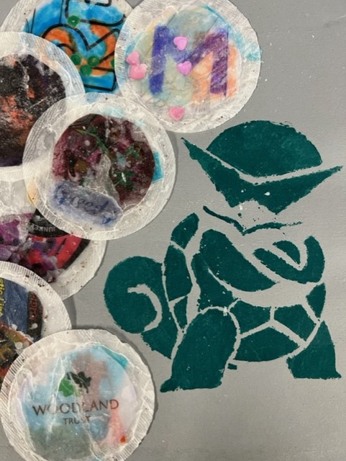
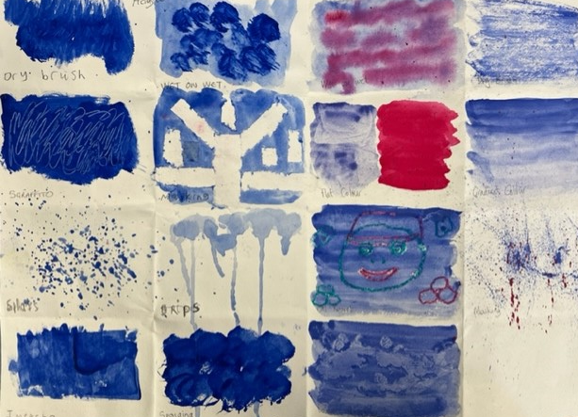
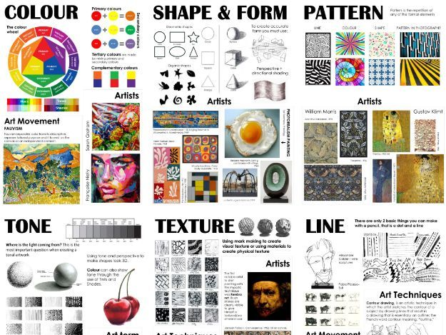
AQA GCSE Art & Design: Fine Art
8202
Assessment Objectives
• AO1: Develop ideas through investigations, demonstrating critical understanding of sources.
• AO2: Refine work by exploring ideas, selecting and experimenting with appropriate media, materials, techniques and processes.
• AO3: Record ideas, observations and insights relevant to intentions as work progresses.
• AO4: Present a personal and meaningful response that realises intentions and demonstrates understanding of visual language.
The Bigger Picture
Complete Coursework
Marks sent into AQA Online
AQA Moderator Visit
Students must not add to or amend work produced during the supervised time; either between sessions of supervised time or after the 10 hours of supervised time has been completed.
Students working independently
Work produced in the supervised time must be clearly identified as such.
Students working on their own work
Assessment on all AO’s
Display Portfolio of work
Work produced in the supervised time must be clearly identified as such.
10 Hour Exam
Students sat as per seating plan.
Following guidelines set out by JCQ and AQA
Following guidelines set out by JCQ and AQA
Evaluate work
Ensure all work is their
Own
Marking work
as it progresses
Preparatory sketchbook work and studies to be taken into the exam room.
Final plan for final piece and organize resources
AO3: Record ideas, observations and insights relevant to intentions as work progresses.
Students must select and respond to one starting point from their chosen title.
Purity and formulations
AO2: Refine work by exploring ideas, selecting and experimenting with appropriate media, materials, techniques and processes.
AO4: Present a personal and meaningful response that realises intentions and demonstrates understanding of visual language.
Critically analyzing their work and that of sources
Marking work
as it progresses
Externally Set Assignment – Exam Preparation
Demonstrate
understanding
of visual language
AO1: Develop ideas through investigations, demonstrating critical understanding of sources.
Fantastic and Strange
Carbon compounds
Ensure all work is labelled as the
Externally set assignment
Preparatory period followed by 10 hours of supervised time • 96 marks • 40% of GCSE
Demonstrate all
The assessment criteria
Preparatory period – from 2 January
Variation and evolution
Purposeful
Experimentation with materials,
Techniques and
Processes.
How sources relate to individual, social, historical, environmental, cultural, ethical and/or issues based contexts
Creating ideas
Responding to the artists
Image manipulation using pixler.com
Selecting appropriate materials, processes and techniques
Year
11
YEAR
Changes of state
11
how ideas, themes, forms, feelings and concerns can inspire personally determined responses that are primarily aesthetic, intellectual or conceptual.
NEA: Fantastic and Strange
Develop ideas through investigations
Fantastic and Strange
digital imagery
charcoal, pastels, pen and ink, crayons and pencil
Drawing for different purposes from small scale studies to large scale tonal sketches
Present a personal response
Demonstrate critical understanding of sources
Photography as recording
Students are asked to explore an idea, convey an experience or respond to a theme or issue of personal significance.
Mood board of ideas and drawings
Artist research
NEA: Fantastic and Strange
Marking work
as it progresses
Natural Forms
Current, potential difference and resistance
Drawing evidence and written annotation required
Spider diagrams
Record initial Response to theme
Producing outcomes in response to the theme Natural Forms
develop their ideas through investigations informed by selecting and critically analysing sources
Fine art: for example drawing, painting, sculpture, installation, lens-/light-based media, photography and the moving image, printmaking, mixed media and land art.
Image Research
monoprint, collagraph and block printing
Artist Research
Working in the style of the artists
Primary sources
figurative representation, abstraction, stylisation, simplification, expression, exaggeration and imaginative interpretation can all be explored
charcoal, pastels, pen and ink, crayons and pencil
NEA: Component 1 - Natural Forms
Observational Drawing
use drawing skills for different needs and purposes, appropriate to context
students are required to work in one or more area(s) of fine art,
Secondary Sources
visual and tactile elements, such as: • colour • line • form • tone • texture • shape • composition • rhythm • scale • structure • surface.
written annotation
Recording ideas, insight
s and observations
a design brief or problem requiring a solution
watercolour, gouache, acrylic and oil paint
Understanding the components of art and what makes it
Mark making
Year
10
digital imagery
NEA: Component 1: Formal Elements and Skills Workshops
A sustained project
characteristics, properties and effects of using different media, materials, techniques and processes, and the ways in which they can be used in relation to students’ own creative intentions
different papers and surfaces on which to work.
found materials
No time limit • 96 marks • 60% of GCSE
Using and understanding the formal elements, including: • colour • line • form • shape • tone • texture

